Slide 1
Artificial Intelligence in Mancala
By:
Morgan Blair &
Michael Blankenship
Mentor:
Uta Ziegler

Slide 2
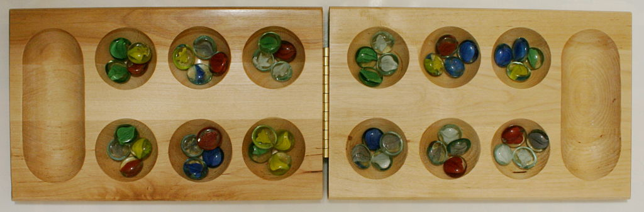
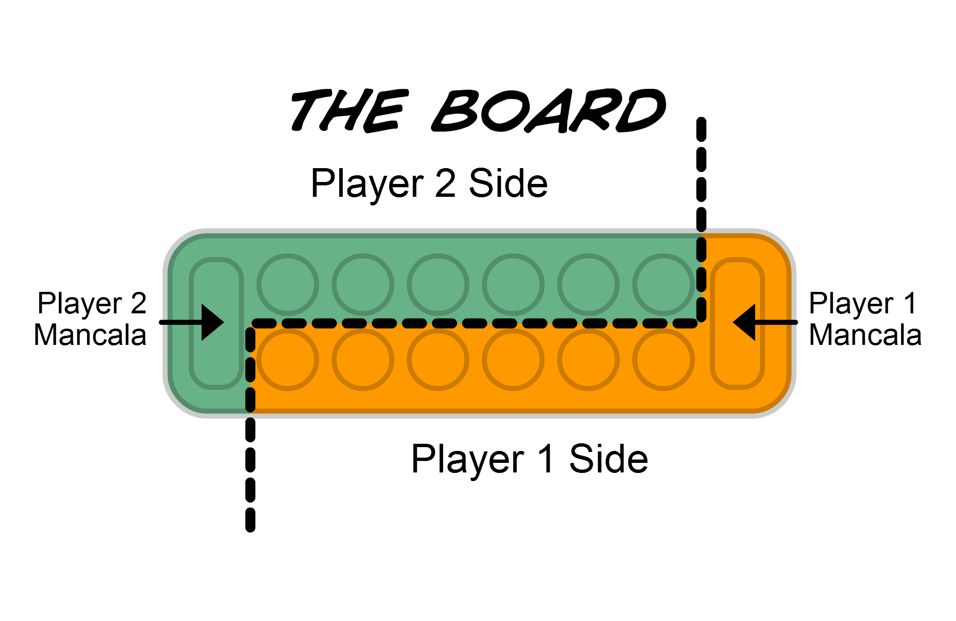
What is Mancala?
Several versions worldwide
Kalah
2 players
6 pits per player
4 stones in each pit
1 store(aka mancala) per player

Slide 3
How to Play?
To take a turn
Pick up all stones in a pit
Traverse CCW and drop a stone at each pit
Skip foe’s store
Turn ends unless last stone falls in a “special” pit
If last stone is in your store, move again.
If last lands in empty pit on own side, capture stones in opposite pit.

Slide 4
How does the game end?
Game ends when all 6 pits on a player’s side becomes empty.
At the end, the player left with stones on his side collects them.
The player with most stones in their respective store wins.

Slide 5
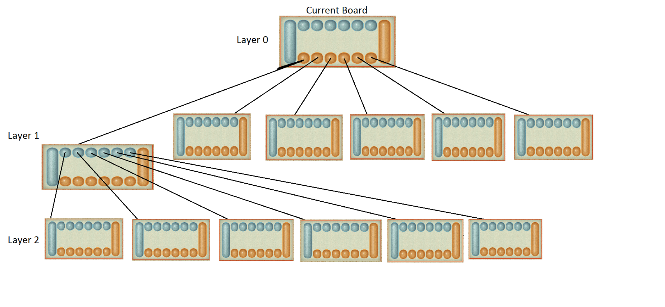

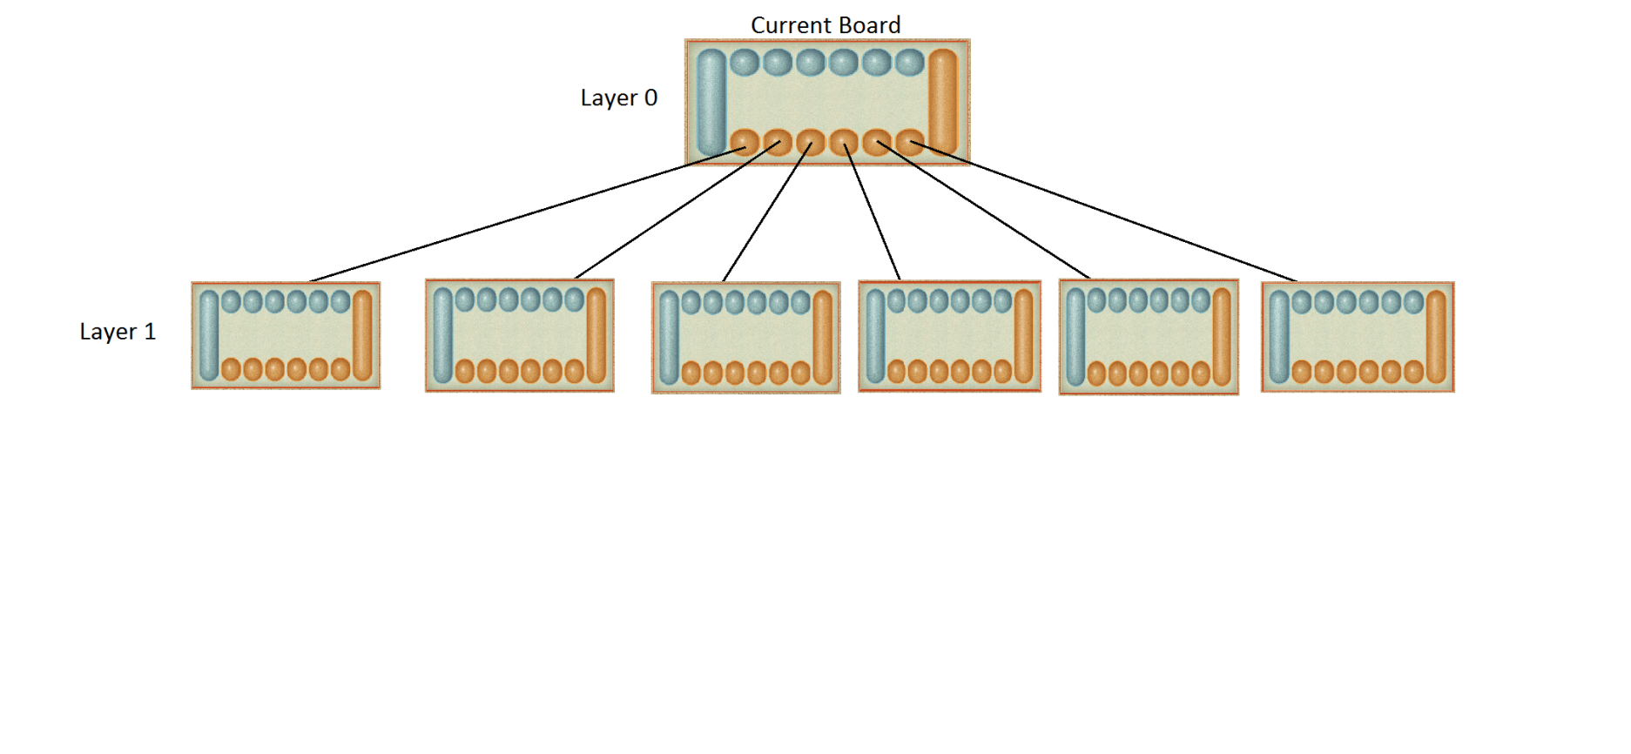
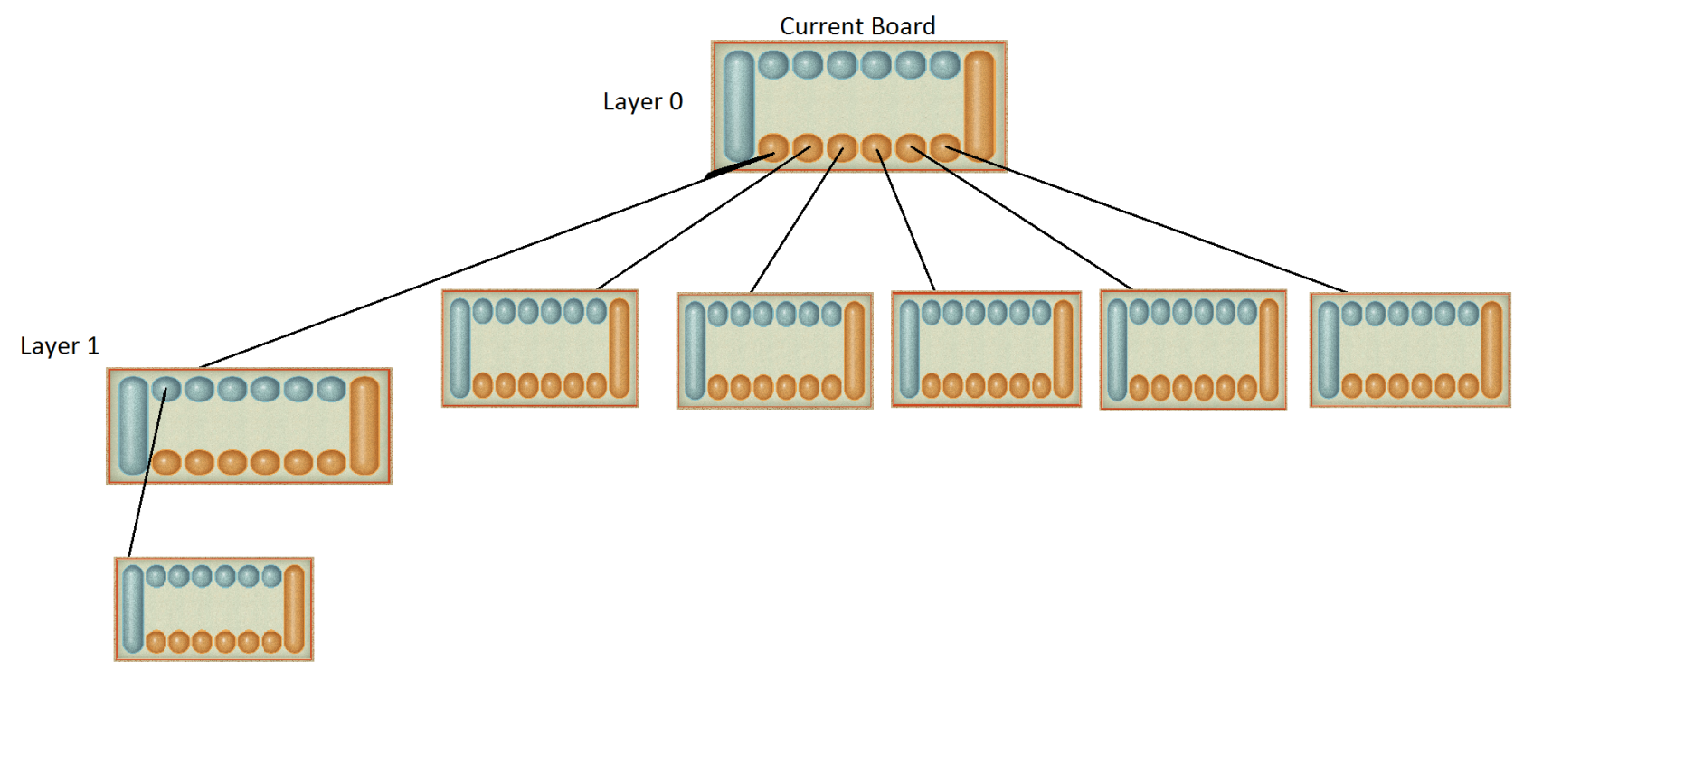
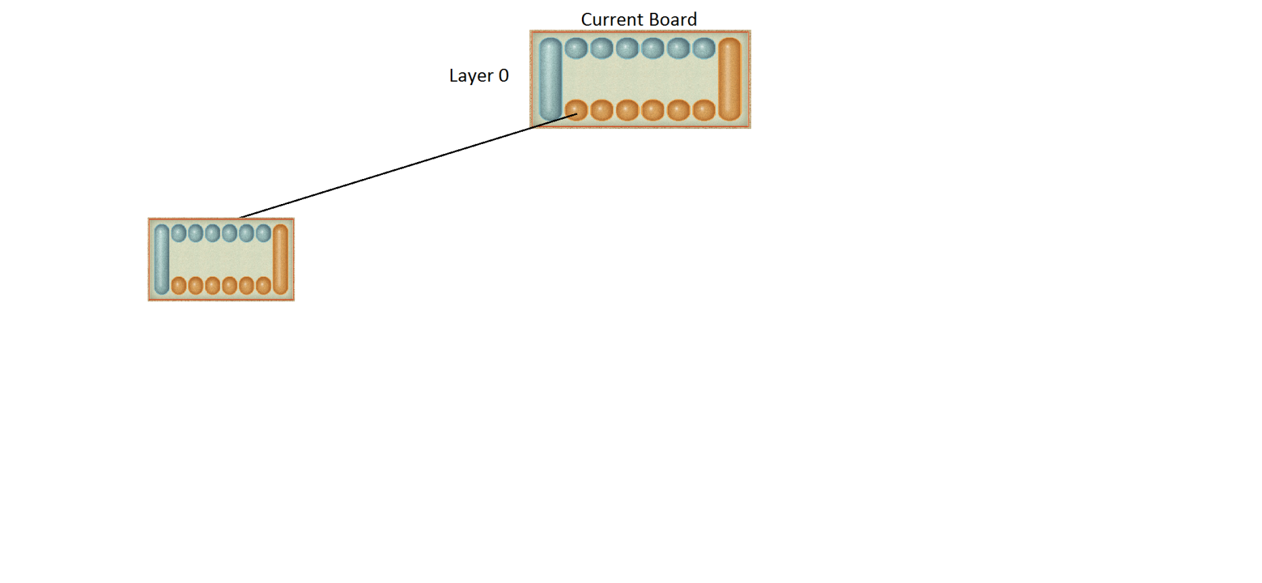
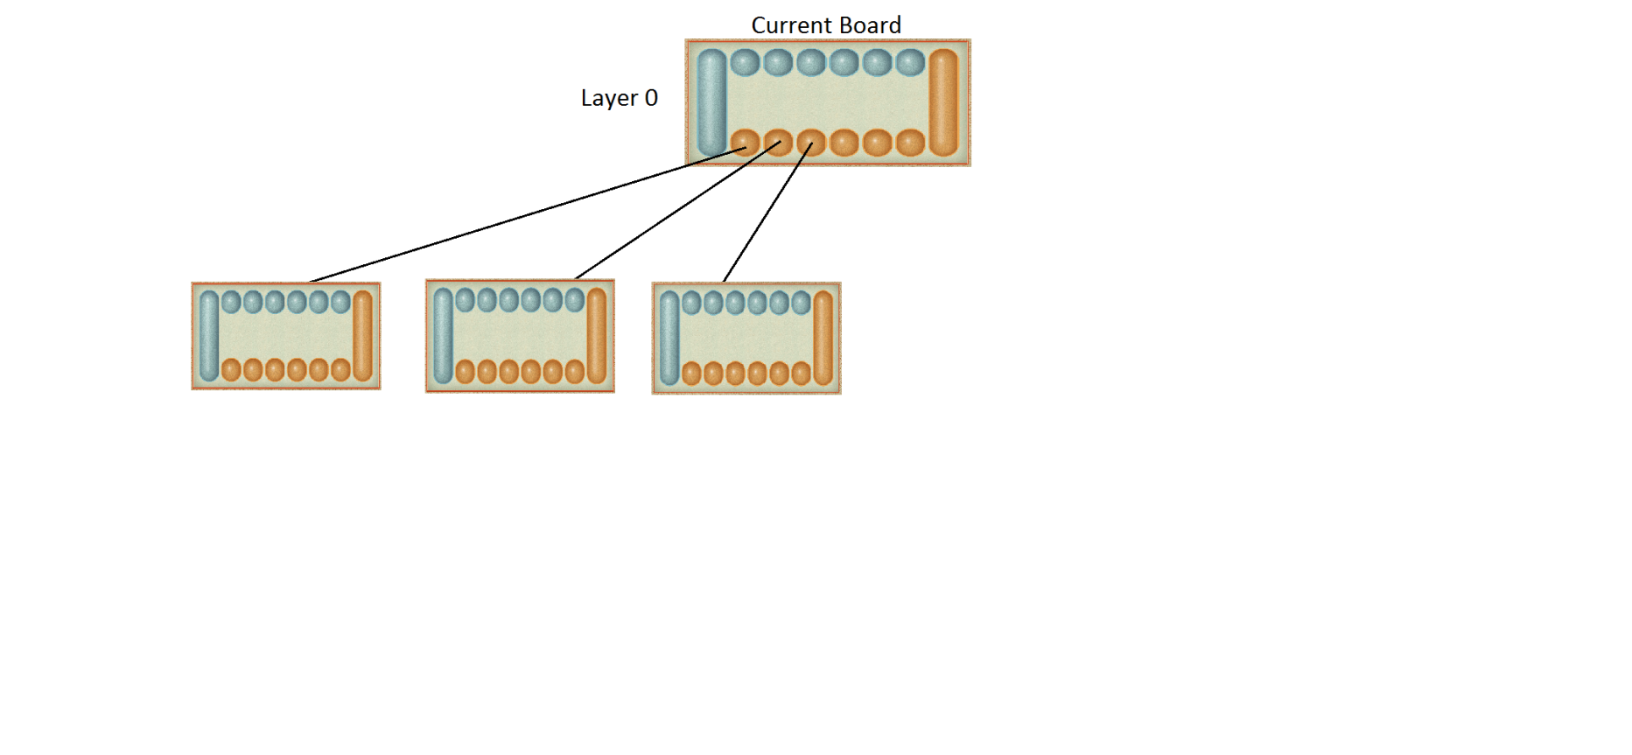
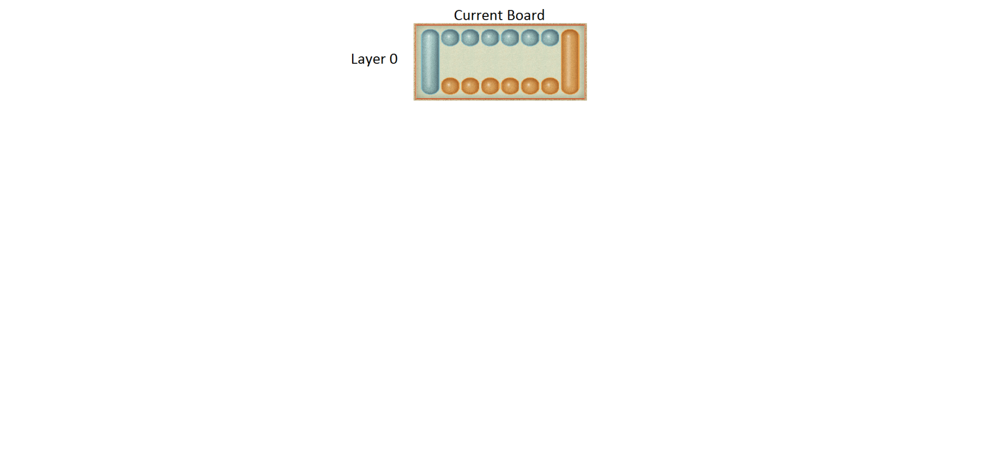
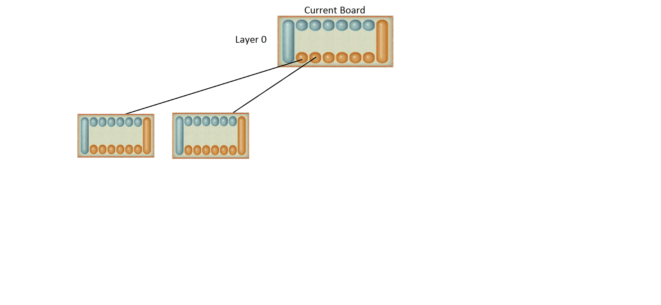
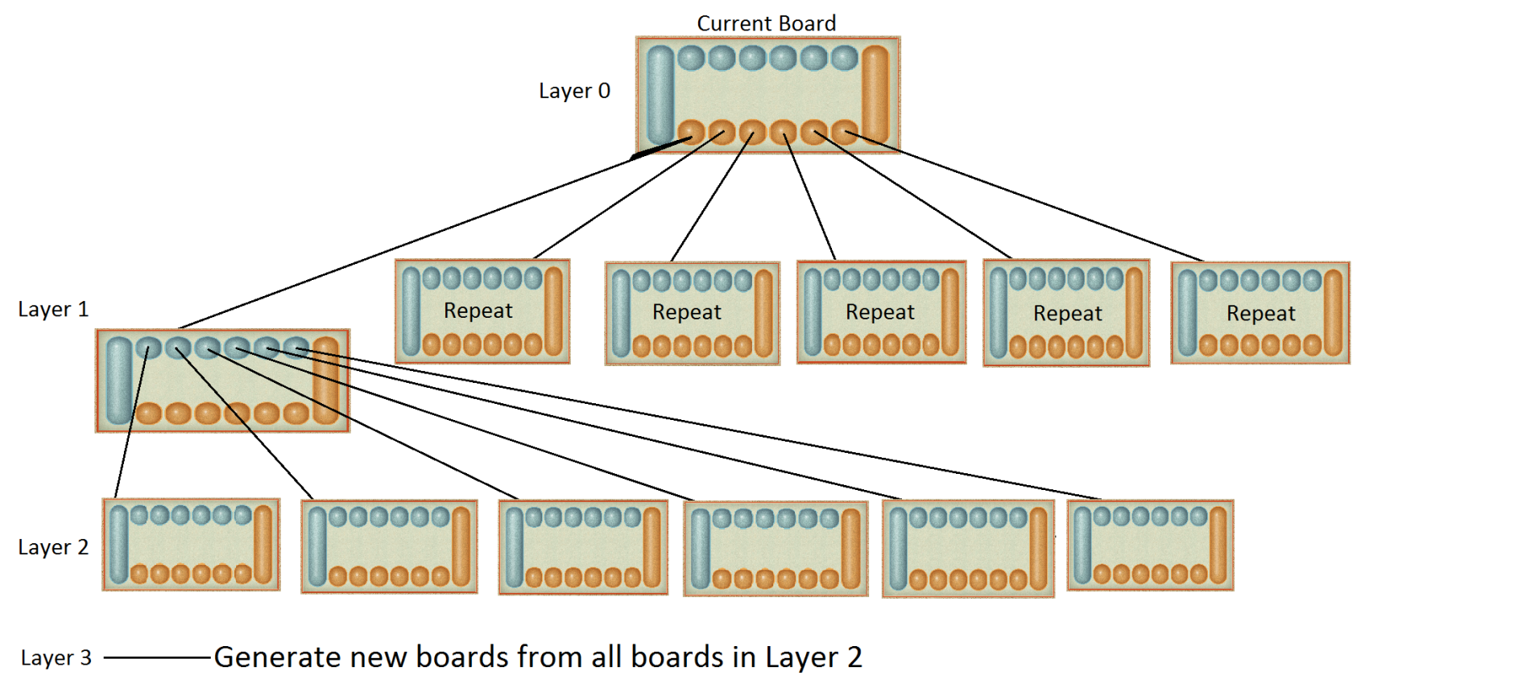
The artificial Intelligence
How can we guarantee the AI will win?!
Generate a tree of future possible moves.
Predict the FUTURE!

Slide 6
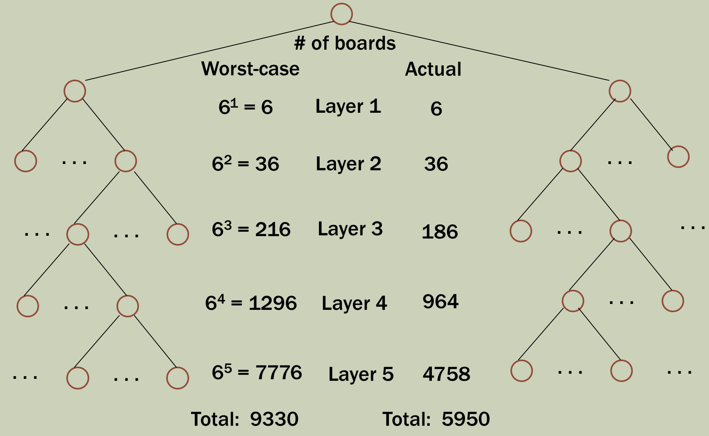
Size of the tree

Slide 7
Evaluating the boards
Need to determine a rating for each board
Sum all stones on AI’s side
Include the pits because of the end-game rule
Include store because the AI is guaranteed those stones.
Must account for other player’s turn

Slide 8
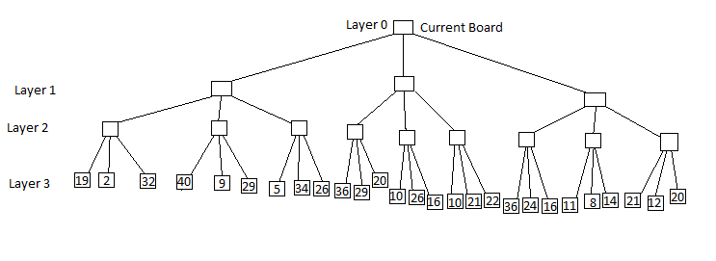
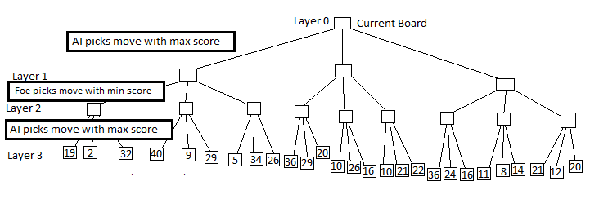
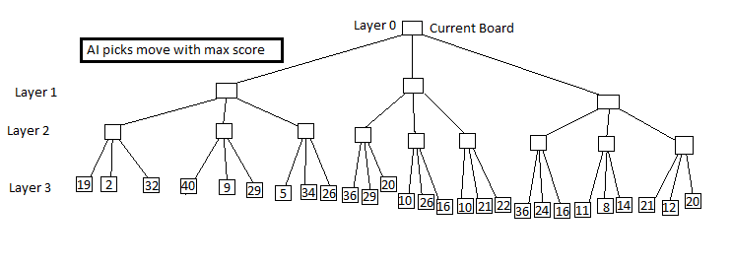
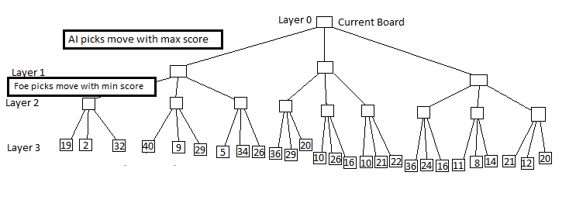

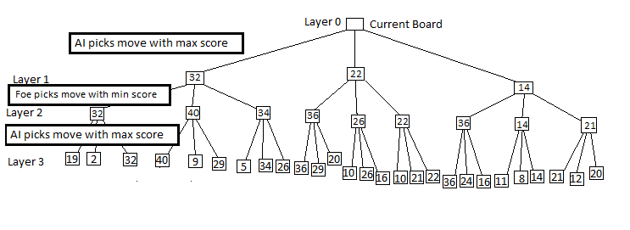

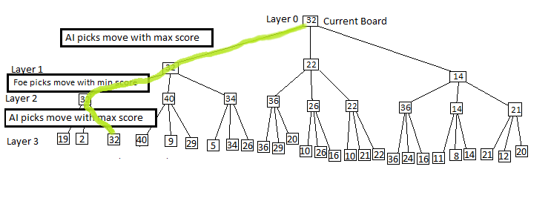
Picking the right move
Using this mini-max algorithm, the AI picks the highest scoring path assuming the worst case scenario.
This means if the foe does not choose the minimum, the AI’s score will increase.
The path the AI chooses may not be the overall maximum.

Slide 9

Limitations
Tree depth
No free move game mechanic

Slide 10
Questions
Thank you Dr. Ziegler for guiding us through this project!

